Slide 1
Design and Analysis of Algorithm Recurrence Equation (Solving Recurrence using Iteration Methods)

Slide 2
Recursive Function
To solve the Recurrence relation the following methods are used:
Iteration method(Backward Substution)
Recursion-Tree method
Master Method
Substitution Method

Slide 3
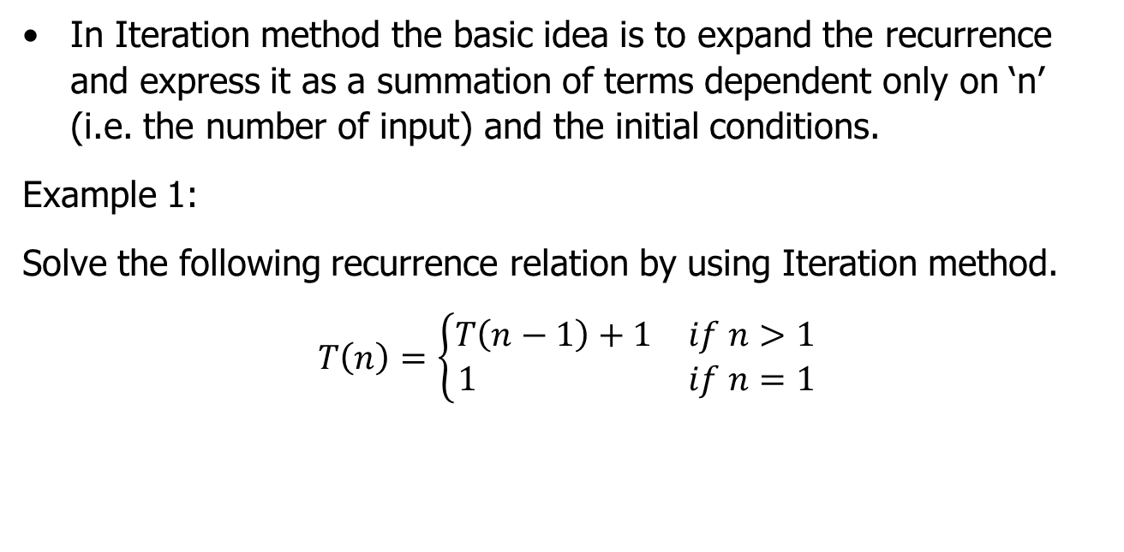
Iteration Method( Example 1)
In Iteration method the basic idea is to expand the recurrence and express it as a summation of terms dependent only on ‘n’ (i.e. the number of input) and the initial conditions.
Example 1:
Solve the following recurrence relation by using Iteration method.
$$T\left(n\right)=\left\{\begin{matrix}T\left(n−1\right)+1 & if n>1 \\ 1 & if n=1\end{matrix}\right.$$

Slide 4
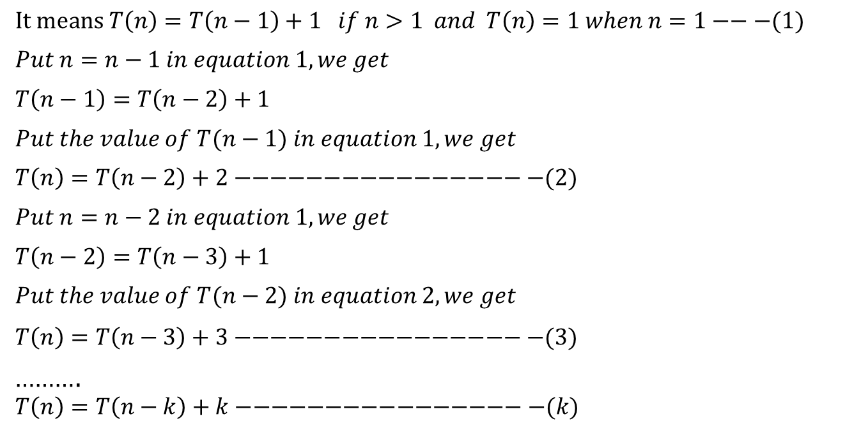
Iteration Method ( Example 1)
$It means T\left(n\right)=T\left(n−1\right)+1 if n>1 and T\left(n\right)=1 when n=1−−−(1)$
$$Put n=n−1 in equation 1, we get$$
$$T\left(n−1\right)=T\left(n−2\right)+1$$
$$Put the value of T(n−1) in equation 1, we get$$
$$T\left(n\right)=T\left(n−2\right)+2−−−−−−−−−−−−−−−−−(2)$$
$$Put n=n−2 in equation 1, we get$$
$$T\left(n−2\right)=T\left(n−3\right)+1$$
$$Put the value of T(n−2) in equation 2, we get$$
$$T\left(n\right)=T\left(n−3\right)+3−−−−−−−−−−−−−−−−−(3)$$
……….
$$T\left(n\right)=T\left(n−k\right)+k−−−−−−−−−−−−−−−−−(k)$$

Slide 5
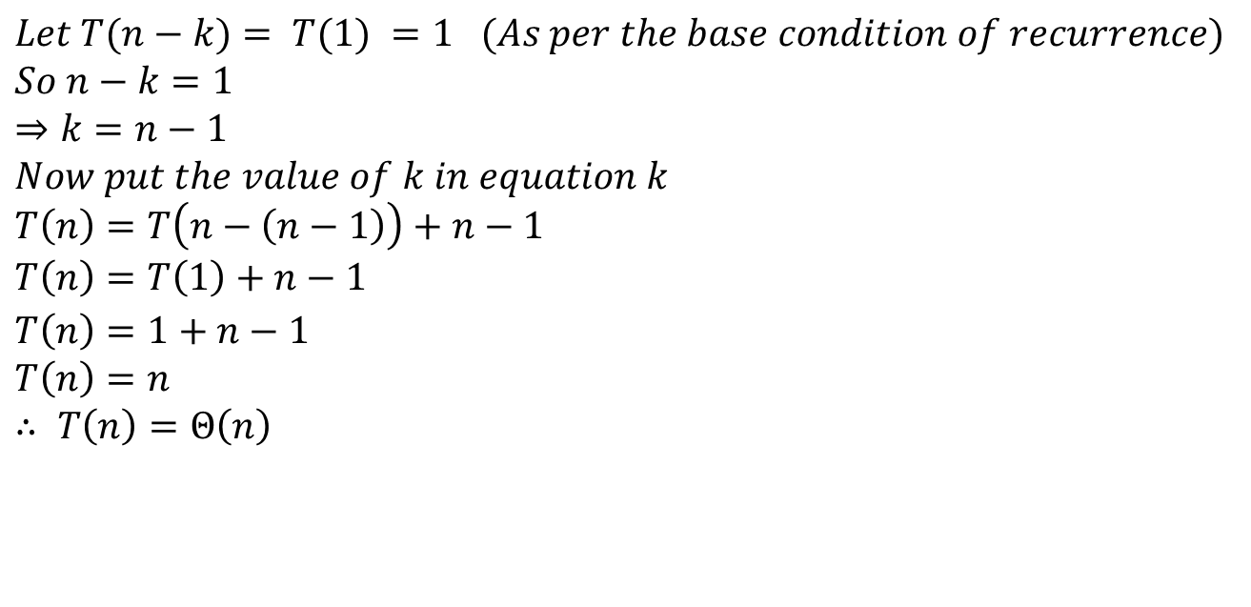
Iteration Method ( Example 1)
$$Let T(n−k)= T(1) =1 (As per the base condition of recurrence)$$
$$So n−k=1$$
$$⇒k=n−1$$
$$Now put the value of k in equation k$$
$$T\left(n\right)=T\left(n−\left(n−1\right)\right)+n−1$$
$$T\left(n\right)=T\left(1\right)+n−1$$
$$T\left(n\right)=1+n−1$$
$$T\left(n\right)=n$$
$$∴ T\left(n\right)=Θ\left(n\right)$$

Slide 6

Iteration Method ( Example 2)
Example 1:
Solve the following recurrence relation by using Iteration method.
$$T\left(n\right)=\left\{\begin{matrix}2T\left(\frac{n}{2}\right)+{3n}^{2} & if n>1 \\ 11 & if n=1\end{matrix}\right.$$

Slide 7
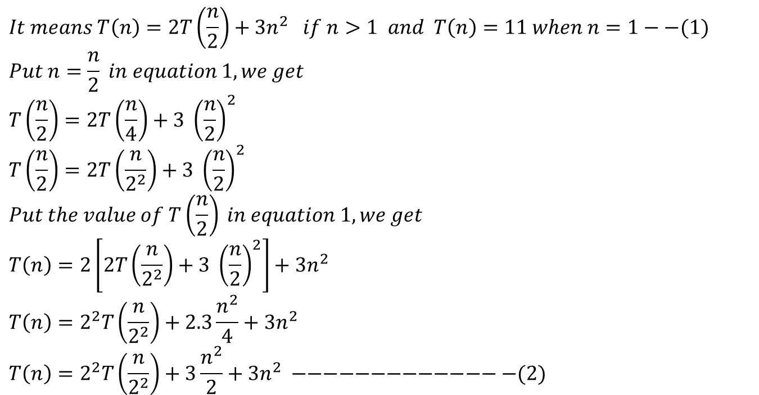
Iteration Method ( Example 2)
$$It means T\left(n\right)=2T\left(\frac{n}{2}\right)+{3n}^{2} if n>1 and T\left(n\right)=11 when n=1−−(1)$$
$$Put n=\frac{n}{2} in equation 1, we get$$
$$T\left(\frac{n}{2}\right)=2T\left(\frac{n}{4}\right)+3 {\left(\frac{n}{2}\right)}^{2}$$
$$T\left(\frac{n}{2}\right)=2T\left(\frac{n}{2^{2}}\right)+3 {\left(\frac{n}{2}\right)}^{2}$$
$$Put the value of T\left(\frac{n}{2}\right) in equation 1, we get$$
$$T\left(n\right)=2\left[2T\left(\frac{n}{2^{2}}\right)+3 {\left(\frac{n}{2}\right)}^{2}\right]+{3n}^{2}$$
$$T\left(n\right)=2^{2}T\left(\frac{n}{2^{2}}\right)+2.3\frac{n^{2}}{4}+{3n}^{2}$$
$$T\left(n\right)=2^{2}T\left(\frac{n}{2^{2}}\right)+3\frac{n^{2}}{2}+{3n}^{2} −−−−−−−−−−−−−−(2)$$

Slide 8
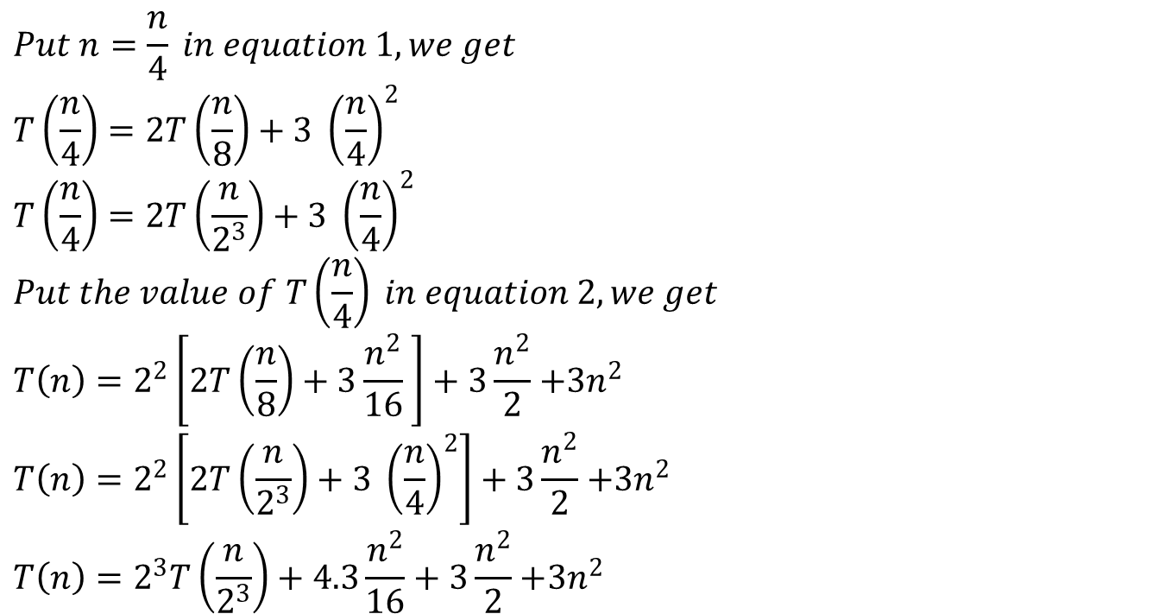
Iteration Method ( Example 2)
$$Put n=\frac{n}{4} in equation 1, we get$$
$$T\left(\frac{n}{4}\right)=2T\left(\frac{n}{8}\right)+3 {\left(\frac{n}{4}\right)}^{2}$$
$$T\left(\frac{n}{4}\right)=2T\left(\frac{n}{2^{3}}\right)+3 {\left(\frac{n}{4}\right)}^{2}$$
$$Put the value of T\left(\frac{n}{4}\right) in equation 2, we get$$
$$T\left(n\right)=2^{2}\left[2T\left(\frac{n}{8}\right)+3\frac{n^{2}}{16} \right]+3\frac{n^{2}}{2}{+3n}^{2}$$
$$T\left(n\right)=2^{2}\left[2T\left(\frac{n}{2^{3}}\right)+3 {\left(\frac{n}{4}\right)}^{2}\right]+3\frac{n^{2}}{2}{+3n}^{2}$$
$$T\left(n\right)=2^{3}T\left(\frac{n}{2^{3}}\right)+4.3\frac{n^{2}}{16}+3\frac{n^{2}}{2}{+3n}^{2}$$

Slide 9
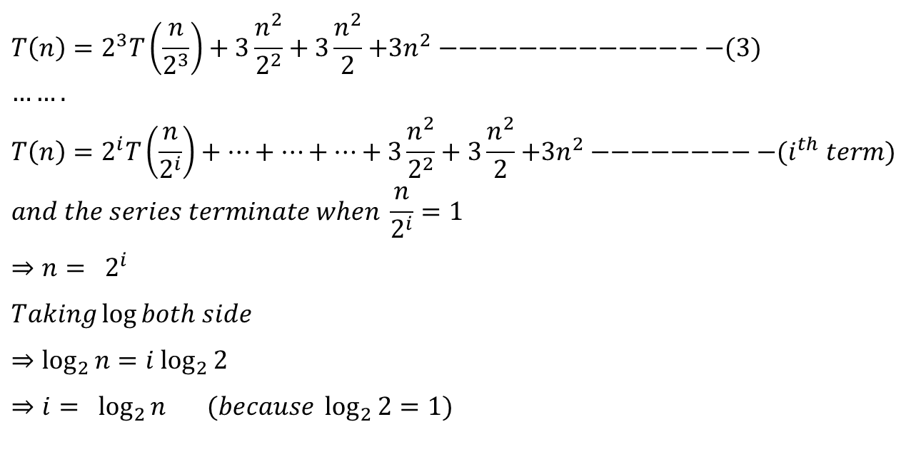
Iteration Method ( Example 2)
$$T\left(n\right)=2^{3}T\left(\frac{n}{2^{3}}\right)+3\frac{n^{2}}{2^{2}}+3\frac{n^{2}}{2}{+3n}^{2} −−−−−−−−−−−−−−(3)$$
$$…….$$
$$T\left(n\right)=2^{i}T\left(\frac{n}{2^{i}}\right)+…+…+…+3\frac{n^{2}}{2^{2}}+3\frac{n^{2}}{2}{+3n}^{2} −−−−−−−−−(i^{th} term)$$
$$and the series terminate when \frac{n}{2^{i}}=1$$
$$⇒n= 2^{i}$$
$$Taking\log{both side}$$
$$⇒\log_{2}{n}=i \log_{2}{2}$$
$$⇒i= \log_{2}{n} (because \log_{2}{2}=1)$$

Slide 10
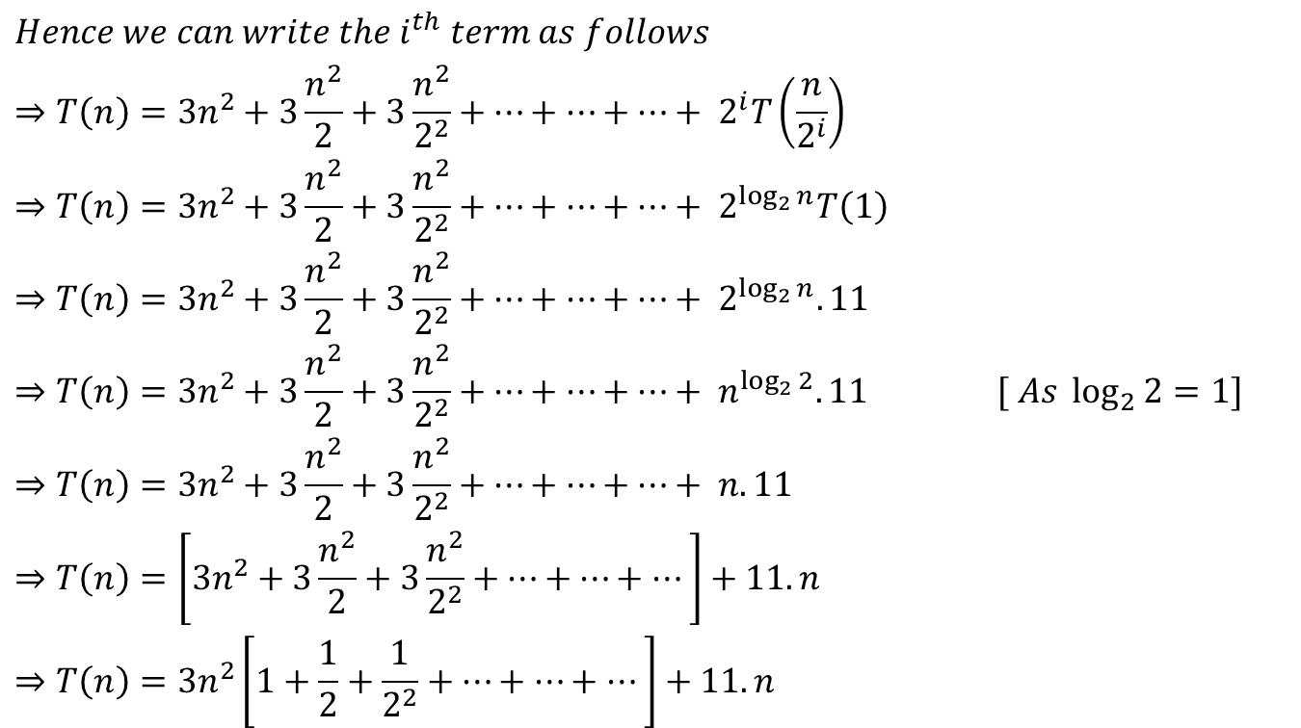
Iteration Method ( Example 2)
$$Hence we can write the i^{th} term as follows$$
$$⇒T\left(n\right)={3n}^{2}+3\frac{n^{2}}{2}+3\frac{n^{2}}{2^{2}}+…+…+…+ 2^{i}T\left(\frac{n}{2^{i}}\right)$$
$$⇒T\left(n\right)={3n}^{2}+3\frac{n^{2}}{2}+3\frac{n^{2}}{2^{2}}+…+…+…+ 2^{\log_{2}{n}}T\left(1\right)$$
$$⇒T\left(n\right)={3n}^{2}+3\frac{n^{2}}{2}+3\frac{n^{2}}{2^{2}}+…+…+…+ 2^{\log_{2}{n}}. 11$$
$$⇒T\left(n\right)={3n}^{2}+3\frac{n^{2}}{2}+3\frac{n^{2}}{2^{2}}+…+…+…+ n^{\log_{2}{2}}. 11 [ As \log_{2}{2}=1]$$
$$⇒T\left(n\right)={3n}^{2}+3\frac{n^{2}}{2}+3\frac{n^{2}}{2^{2}}+…+…+…+ n. 11$$
$$⇒T\left(n\right)=\left[{3n}^{2}+3\frac{n^{2}}{2}+3\frac{n^{2}}{2^{2}}+…+…+…\right]+11. n$$
$$⇒T\left(n\right)={3n}^{2}\left[1+\frac{1}{2}+\frac{1}{2^{2}}+…+…+…\right]+11. n$$

Slide 11
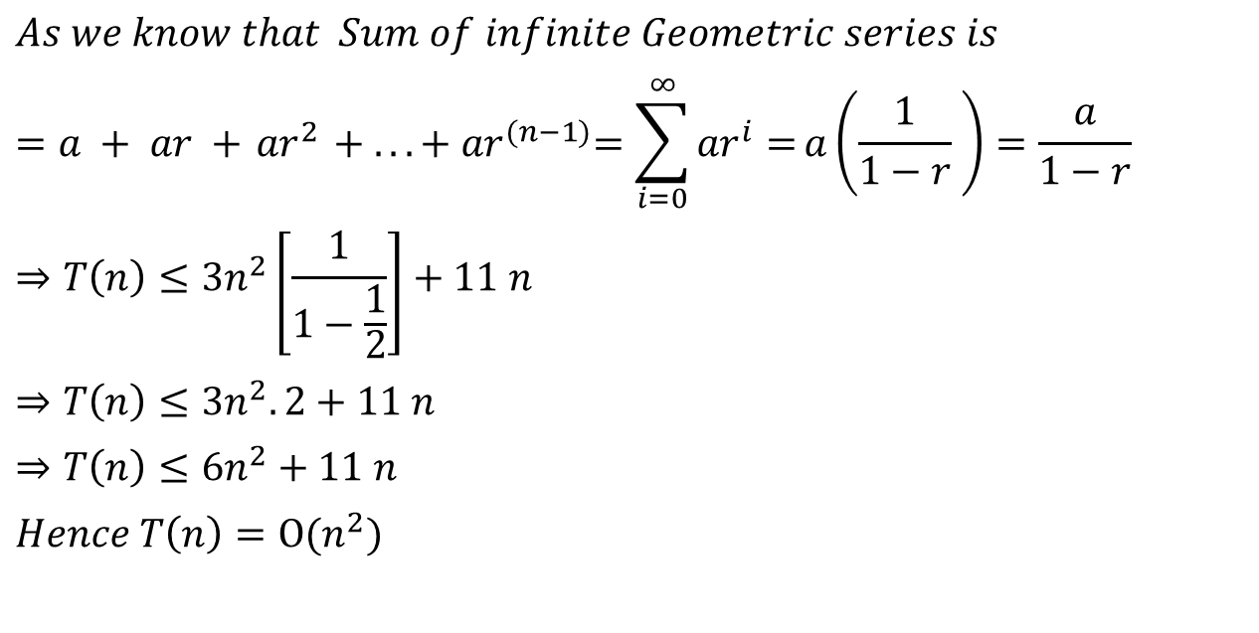
Iteration Method ( Example 2)
$$As we know that Sum of infinite Geometric series is$$
$$=a + ar +{ ar}^{2} + ... +{ ar}^{(n−1)}=\sum_{i=0}^{∞}{{ar}^{i}=}a\left(\frac{1}{1−r} \right)=\frac{a}{1−r}$$
$$⇒T\left(n\right)≤{3n}^{2}\left[\frac{1}{1−\frac{1}{2}}\right]+11 n$$
$$⇒T\left(n\right)≤{3n}^{2}.2+11 n$$
$$⇒T\left(n\right)≤{6n}^{2}+11 n$$
$$Hence T\left(n\right)=Ο(n^{2})$$

Slide 12

Iteration Method ( Example 3)
Example 3:
Solve the following recurrence relation by using Iteration method.
$$T\left(n\right)=\left\{\begin{matrix}8T\left(\frac{n}{2}\right)+n^{2} & if n>1 \\ 1 & if n=1\end{matrix}\right.$$

Slide 13
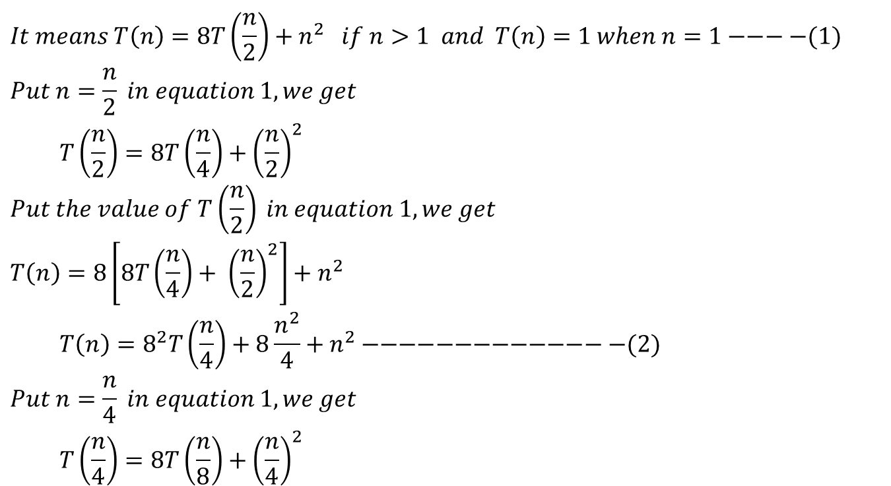
Iteration Method ( Example 3)
$$It means T\left(n\right)=8T\left(\frac{n}{2}\right)+n^{2} if n>1 and T\left(n\right)=1 when n=1−−−−(1)$$
$$Put n=\frac{n}{2} in equation 1, we get$$
$$T\left(\frac{n}{2}\right)=8T\left(\frac{n}{4}\right)+{\left(\frac{n}{2}\right)}^{2}$$
$$Put the value of T\left(\frac{n}{2}\right) in equation 1, we get$$
$$T\left(n\right)=8\left[8T\left(\frac{n}{4}\right)+ {\left(\frac{n}{2}\right)}^{2}\right]+n^{2}$$
$$T\left(n\right)=8^{2}T\left(\frac{n}{4}\right)+8\frac{n^{2}}{4}+n^{2}−−−−−−−−−−−−−−(2)$$
$$Put n=\frac{n}{4} in equation 1, we get$$
$$T\left(\frac{n}{4}\right)=8T\left(\frac{n}{8}\right)+{\left(\frac{n}{4}\right)}^{2}$$

Slide 14
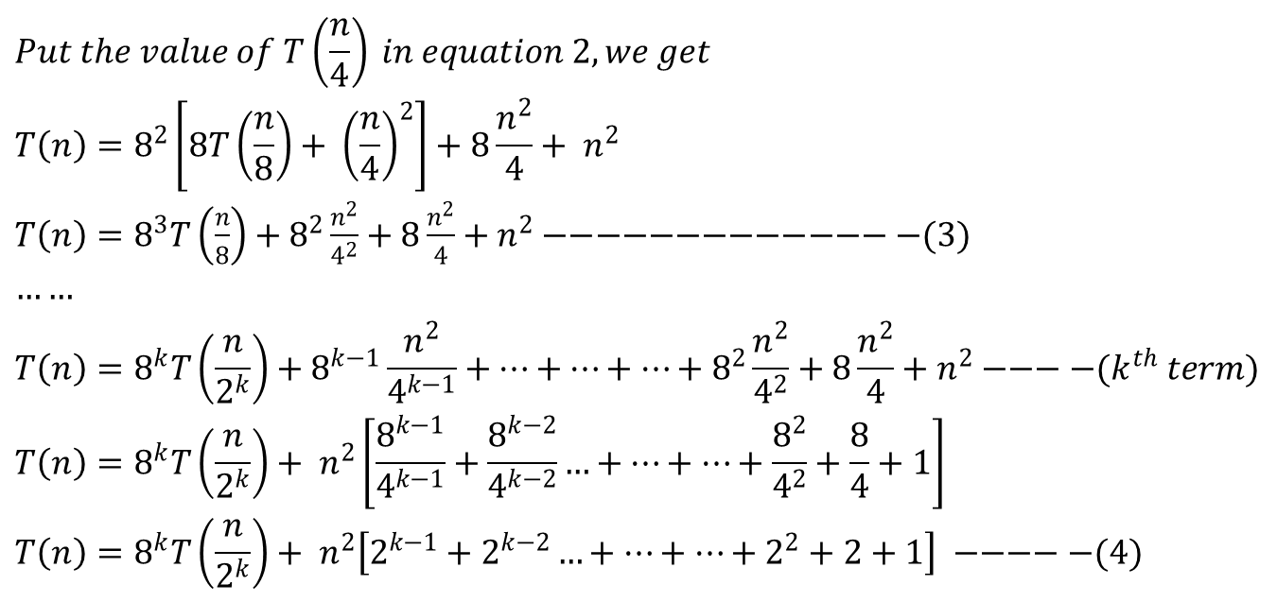
Iteration Method ( Example 3)
$$Put the value of T\left(\frac{n}{4}\right) in equation 2, we get$$
$$T\left(n\right)=8^{2}\left[8T\left(\frac{n}{8}\right)+ {\left(\frac{n}{4}\right)}^{2}\right]+8\frac{n^{2}}{4}+ n^{2}$$
$T\left(n\right)=8^{3}T\left(\frac{n}{8}\right)+8^{2}\frac{n^{2}}{4^{2}}+8\frac{n^{2}}{4}+n^{2}−−−−−−−−−−−−−−(3)$
$$……$$
$$T\left(n\right)=8^{k}T\left(\frac{n}{2^{k}}\right)+8^{k−1}\frac{n^{2}}{4^{k−1}}+…+…+…+8^{2}\frac{n^{2}}{4^{2}}+8\frac{n^{2}}{4}+n^{2}−−−−(k^{th} term)$$
$$T\left(n\right)=8^{k}T\left(\frac{n}{2^{k}}\right)+ n^{2}\left[\frac{8^{k−1}}{4^{k−1}}+\frac{8^{k−2}}{4^{k−2}}…+…+…+\frac{8^{2}}{4^{2}}+\frac{8}{4}+1\right]$$
$$T\left(n\right)=8^{k}T\left(\frac{n}{2^{k}}\right)+ n^{2}\left[2^{k−1}+2^{k−2}…+…+…+2^{2}+2+1\right] −−−−−(4)$$

Slide 15
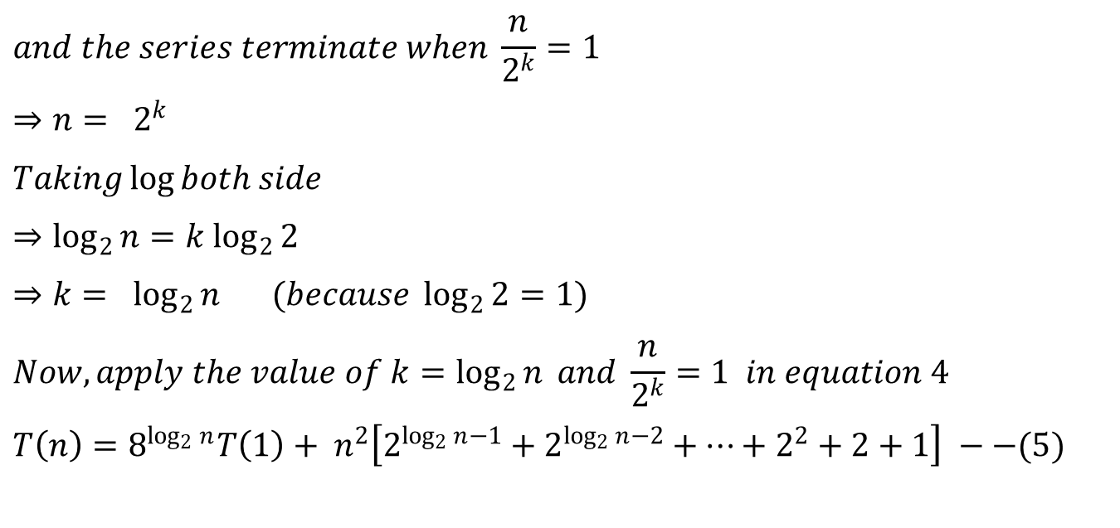
Iteration Method ( Example 3)
$$and the series terminate when \frac{n}{2^{k}}=1$$
$$⇒n= 2^{k}$$
$$Taking\log{both side}$$
$$⇒\log_{2}{n}=k \log_{2}{2}$$
$$⇒k= \log_{2}{n} (because \log_{2}{2}=1)$$
$$Now, apply the value of k=\log_{2}{n} and \frac{n}{2^{k}}=1 in equation 4$$
$$T\left(n\right)=8^{\log_{2}{n}}T\left(1\right)+ n^{2}\left[2^{\log_{2}{n}−1}+2^{\log_{2}{n}−2}+…+2^{2}+2+1\right] −−(5)$$

Slide 16
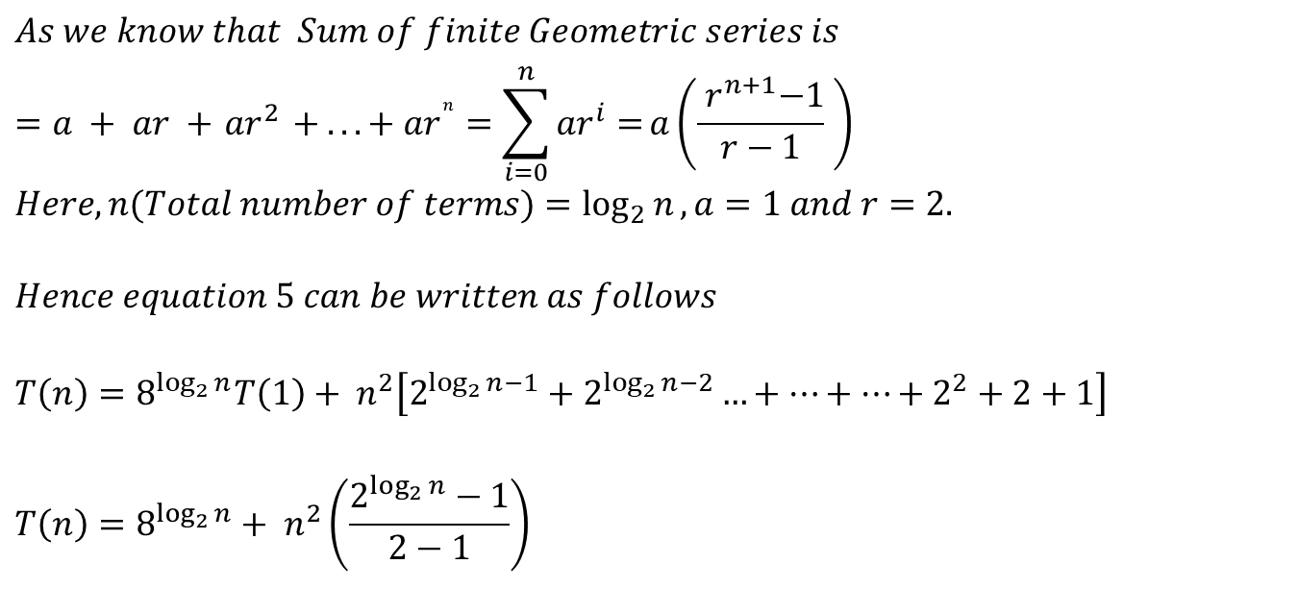
Iteration Method ( Example 3)
$$As we know that Sum of finite Geometric series is$$
$$=a + ar +{ ar}^{2} + ... + {ar}^{n}=\sum_{i=0}^{n}{{ar}^{i}=}a\left(\frac{{ r}^{n+1}−1}{r−1} \right)$$
$$Here, n(Total number of terms)=\log_{2}{n}, a=1 and r=2.$$
$$Hence equation 5 can be written as follows$$
$$T\left(n\right)=8^{\log_{2}{n}}T\left(1\right)+ n^{2}\left[2^{\log_{2}{n}−1}+2^{\log_{2}{n}−2}…+…+…+2^{2}+2+1\right]$$
$$T\left(n\right)=8^{\log_{2}{n}}+ n^{2}\left(\frac{2^{\log_{2}{n}}−1}{2−1}\right)$$

Slide 17
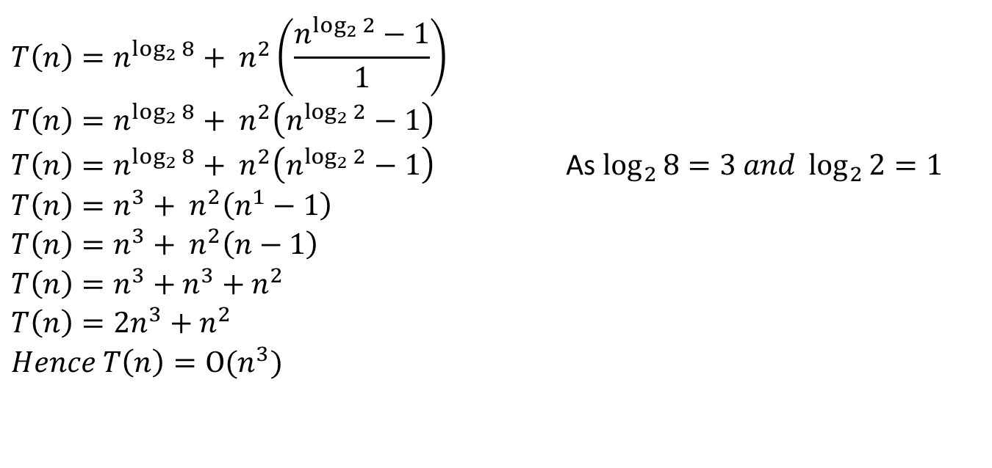
Iteration Method ( Example 3)
$$T\left(n\right)=n^{\log_{2}{8}}+ n^{2}\left(\frac{n^{\log_{2}{2}}−1}{1}\right)$$
$$T\left(n\right)=n^{\log_{2}{8}}+ n^{2}\left(n^{\log_{2}{2}}−1\right)$$
$T\left(n\right)=n^{\log_{2}{8}}+ n^{2}\left(n^{\log_{2}{2}}−1\right)$ As $\log_{2}{8}=3 and \log_{2}{2}=1$
$$T\left(n\right)=n^{3}+ n^{2}\left(n^{1}−1\right)$$
$$T\left(n\right)=n^{3}+ n^{2}\left(n−1\right)$$
$$T\left(n\right)=n^{3}+n^{3}+n^{2}$$
$$T\left(n\right)=2n^{3}+n^{2}$$
$$Hence T\left(n\right)=Ο(n^{3})$$

Slide 18

Iteration Method ( Example 4)
Example 4:
Solve the following recurrence relation by using Iteration method.
$$T\left(n\right)=\left\{\begin{matrix}7T\left(\frac{n}{2}\right)+n^{2} & if n>1 \\ 1 & if n=1\end{matrix}\right.$$
$$(i.e. Strassion Algorithm)$$

Slide 20
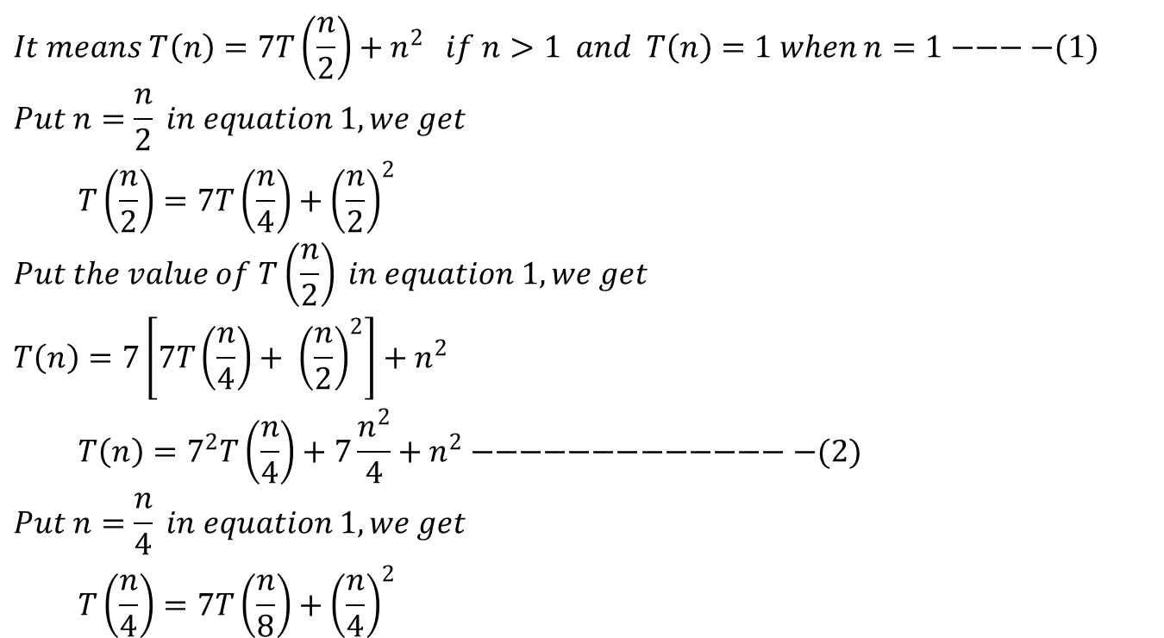
Iteration Method ( Example 4)
$$It means T\left(n\right)=7T\left(\frac{n}{2}\right)+n^{2} if n>1 and T\left(n\right)=1 when n=1−−−−(1)$$
$$Put n=\frac{n}{2} in equation 1, we get$$
$$T\left(\frac{n}{2}\right)=7T\left(\frac{n}{4}\right)+{\left(\frac{n}{2}\right)}^{2}$$
$$Put the value of T\left(\frac{n}{2}\right) in equation 1, we get$$
$$T\left(n\right)=7\left[7T\left(\frac{n}{4}\right)+ {\left(\frac{n}{2}\right)}^{2}\right]+n^{2}$$
$$T\left(n\right)=7^{2}T\left(\frac{n}{4}\right)+7\frac{n^{2}}{4}+n^{2}−−−−−−−−−−−−−−(2)$$
$$Put n=\frac{n}{4} in equation 1, we get$$
$$T\left(\frac{n}{4}\right)=7T\left(\frac{n}{8}\right)+{\left(\frac{n}{4}\right)}^{2}$$

Slide 21
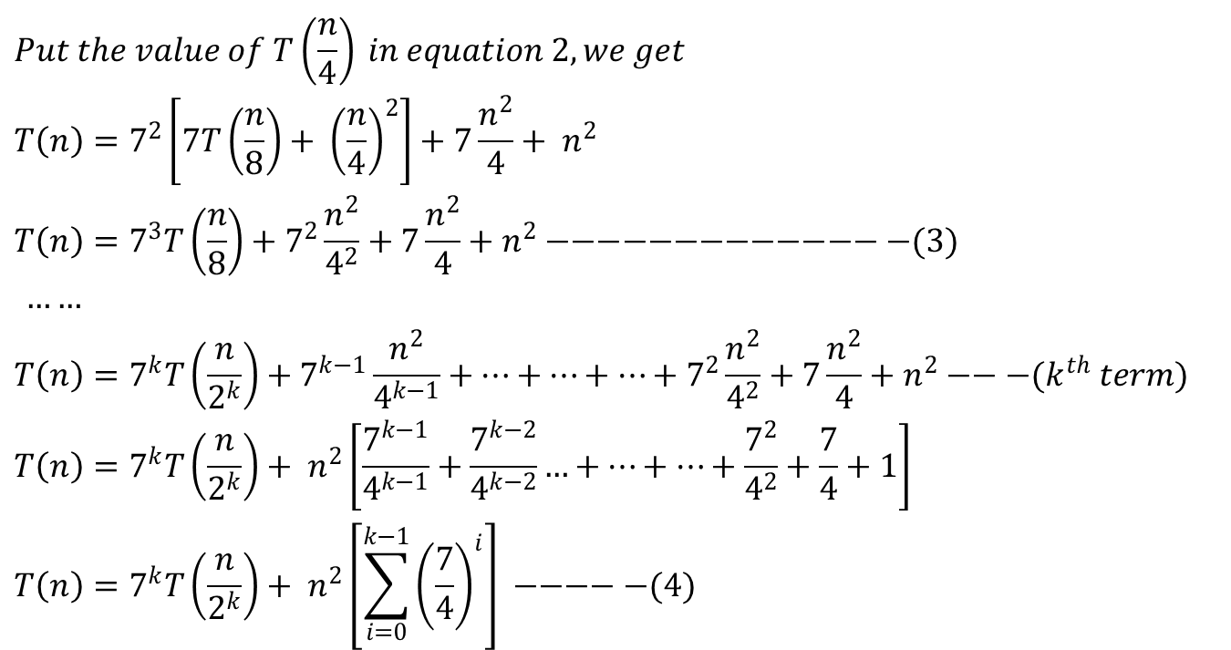
Iteration Method ( Example 4)
$$Put the value of T\left(\frac{n}{4}\right) in equation 2, we get$$
$$T\left(n\right)=7^{2}\left[7T\left(\frac{n}{8}\right)+ {\left(\frac{n}{4}\right)}^{2}\right]+7\frac{n^{2}}{4}+ n^{2}$$
$$T\left(n\right)=7^{3}T\left(\frac{n}{8}\right)+7^{2}\frac{n^{2}}{4^{2}}+7\frac{n^{2}}{4}+n^{2}−−−−−−−−−−−−−−(3)$$
$……$
$$T\left(n\right)=7^{k}T\left(\frac{n}{2^{k}}\right)+7^{k−1}\frac{n^{2}}{4^{k−1}}+…+…+…+7^{2}\frac{n^{2}}{4^{2}}+7\frac{n^{2}}{4}+n^{2}−−−(k^{th} term)$$
$$T\left(n\right)=7^{k}T\left(\frac{n}{2^{k}}\right)+ n^{2}\left[\frac{7^{k−1}}{4^{k−1}}+\frac{7^{k−2}}{4^{k−2}}…+…+…+\frac{7^{2}}{4^{2}}+\frac{7}{4}+1\right]$$
$$T\left(n\right)=7^{k}T\left(\frac{n}{2^{k}}\right)+ n^{2}\left[\sum_{i=0}^{k−1}{{\left(\frac{7}{4}\right)}^{i}}\right] −−−−−(4)$$

Slide 22
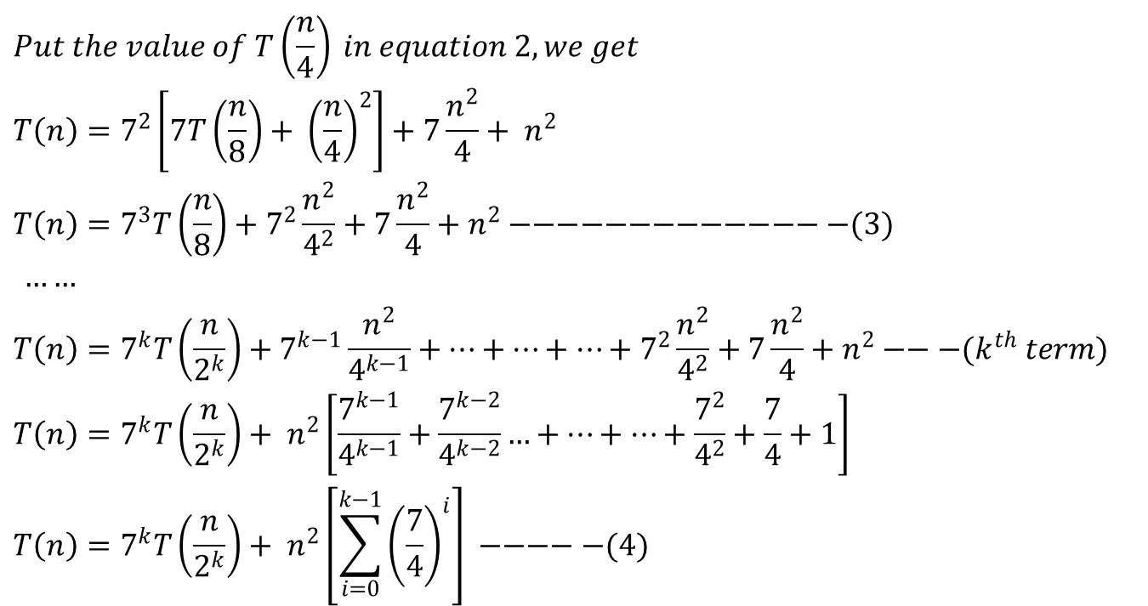
Iteration Method ( Example 4)
$$Put the value of T\left(\frac{n}{4}\right) in equation 2, we get$$
$$T\left(n\right)=7^{2}\left[7T\left(\frac{n}{8}\right)+ {\left(\frac{n}{4}\right)}^{2}\right]+7\frac{n^{2}}{4}+ n^{2}$$
$$T\left(n\right)=7^{3}T\left(\frac{n}{8}\right)+7^{2}\frac{n^{2}}{4^{2}}+7\frac{n^{2}}{4}+n^{2}−−−−−−−−−−−−−−(3)$$
$……$
$$T\left(n\right)=7^{k}T\left(\frac{n}{2^{k}}\right)+7^{k−1}\frac{n^{2}}{4^{k−1}}+…+…+…+7^{2}\frac{n^{2}}{4^{2}}+7\frac{n^{2}}{4}+n^{2}−−−(k^{th} term)$$
$$T\left(n\right)=7^{k}T\left(\frac{n}{2^{k}}\right)+ n^{2}\left[\frac{7^{k−1}}{4^{k−1}}+\frac{7^{k−2}}{4^{k−2}}…+…+…+\frac{7^{2}}{4^{2}}+\frac{7}{4}+1\right]$$
$$T\left(n\right)=7^{k}T\left(\frac{n}{2^{k}}\right)+ n^{2}\left[\sum_{i=0}^{k−1}{{\left(\frac{7}{4}\right)}^{i}}\right] −−−−−(4)$$

Slide 23
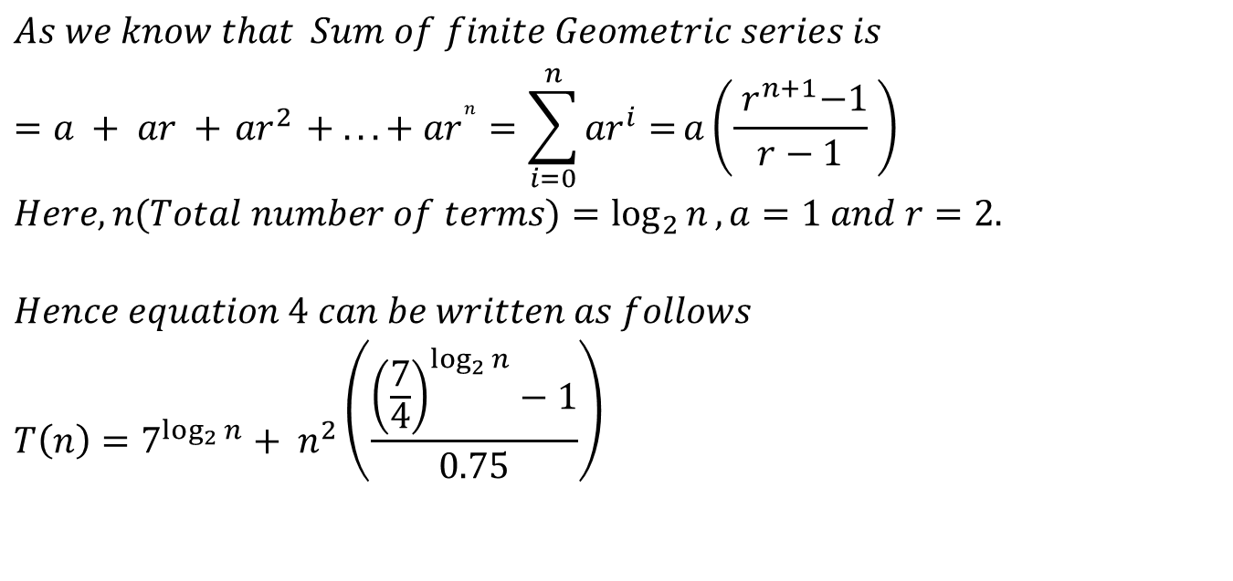
Iteration Method ( Example 4)
$$As we know that Sum of finite Geometric series is$$
$$=a + ar +{ ar}^{2} + ... + {ar}^{n}=\sum_{i=0}^{n}{{ar}^{i}=}a\left(\frac{{ r}^{n+1}−1}{r−1} \right)$$
$$Here, n(Total number of terms)=\log_{2}{n}, a=1 and r=2.$$
$$Hence equation 4 can be written as follows$$
$$T\left(n\right)=7^{\log_{2}{n}}+ n^{2}\left(\frac{{\left(\frac{7}{4}\right)}^{\log_{2}{n}}−1}{0.75}\right)$$

Slide 24
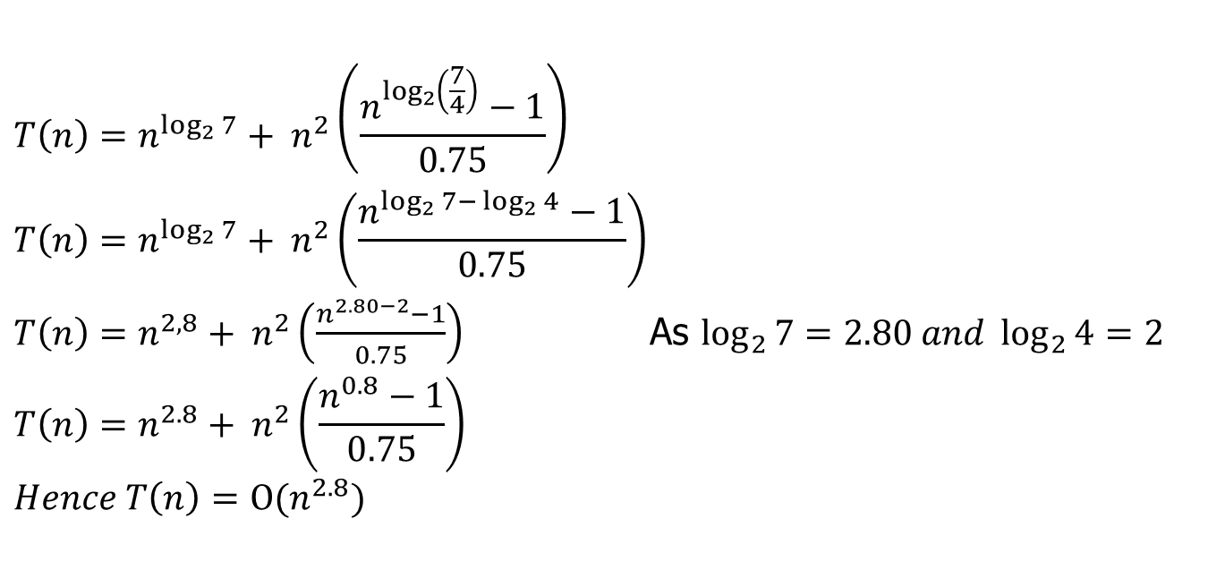
Iteration Method ( Example 4)
$$T\left(n\right)=n^{\log_{2}{7}}+ n^{2}\left(\frac{n^{\log_{2}\left(\frac{7}{4}\right)}−1}{0.75}\right)$$
$$T\left(n\right)=n^{\log_{2}{7}}+ n^{2}\left(\frac{n^{\log_{2}{7−}\log_{2}{4}}−1}{0.75}\right)$$
$T\left(n\right)=n^{2,8}+ n^{2}\left(\frac{n^{2.80−2}−1}{0.75}\right)$ As $\log_{2}{7}=2.80 and \log_{2}{4}=2$
$$T\left(n\right)=n^{2.8}+ n^{2}\left(\frac{n^{0.8}−1}{0.75}\right)$$
$Hence T\left(n\right)=Ο(n^{2.8})$

Slide 25

Thank U

